Slide 1
Booting from hard disk…
Starting Windos 2…
Press here to boot

Slide 2



Slide 4
You have successfully muted the start up sound.
Click on any part of the screen to go back to the desktop.
This button mutes the start-up sound if you wish to ignore it.
Tap on the background to return to desktop.

Slide 5




Windos 2
beta 3
For testing purposes ONLY
Shortcuts:
All apps
Computer
Browser
Email
What’s new:
Added 1 email
Announcement: this is the 1st OFFICIAL build of Windos!
Added MIME 1.01 website.
Fixed red outline in boot screen!
Added MIME 1.01 website!
Updated Googlee website
Added Wotsits website
Hint of the version:
click on browser to browse the Intranet!
Email
There are 0 messages waiting for you
Trash-can
start

Slide 6
Memphis the virtual assistant is coming soon!
All apps
Computer
Run
Find ALPHA
Sign out
Power off
Windos 2.0
Click me to exit start menu

Slide 8
From Batman to Bill Gates
To: You
From: Batman000@eyefind.info
SJ: hello there small dude
Hello there Billie Goat Gates!
We are

Slide 9

mime.com. /1.01
Welcome to MIME!
Look at the mime below:

Slide 10
Minecraft

Slide 11
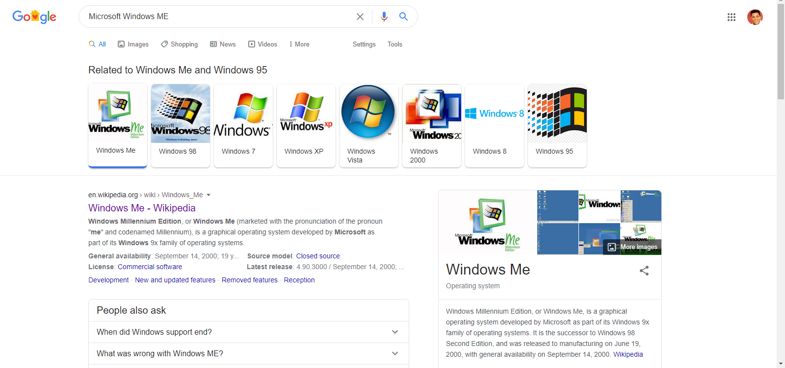
Googlee. Comm/search? Microsoft%Windows%ME=page1
X

Slide 12
Googlee. Comm. ukay
welcome to Googlee!
Search the intranet:
Click on the search bar for result
Microsoft Windows ME

Slide 13
Intranet Explorer CONNECTED TO NETWORK 1.128.256.666
Welcome to the Intranet!
Select a website to browse:
Ask Jeeves*
Googlee
MIME 1.01
Wotsits
*connects to internet site, outside of this VM

Slide 14
Intranet explorer
NO INTERNET
TAP HERE TO CONNECT TO THE INTRANET

Slide 15
Email 1.01
Inbox
Outbox
Sent items
Bin
Exit email
To: Bill Gates
Fr: Batman

Slide 16
Browser 0.10
This browser has been discontinued in mid-development!
Open intranet explorer here:
link
About: hmm
No Intranet

Slide 17
Find ALPHA
File to find:
Windos. exe
Look in:
All drives
This is an alpha program.
You might not get anything!
Search now

Slide 18
C:\
Cannot view folder for some unknown reason.
Please check in the next update

Slide 19

Computer
C:\

Slide 20






All apps
Power menu
browser
email
antivirus+
Intranet explorer
Minecraft
ROBLOX
VirtualBox

Slide 22
Power Off
The device has powered off now!
Press ESC on your keyboard to shut down.
restart

Slide 23
Crashed app
An app you were running just crashed.
Try to re-open it and hope you never lost any data.
We apologise for the inconvenience.

Slide 24
ROBLOX 2020.112.36.0.1.2.3.4.5.6.7.8.9.10.11.12.13 BETA
Is loading
Pls wait…

Slide 25
inetwiz.exe
Connecting to the intranet
Please wait…

Slide 26
Find ALPHA result
Found:
C:\windos\system32\windos.exe
The file is 0.0001Mb in size and was created on : 23/04/2020
Open the file
exit

Slide 27
windos.exe
You cannot tun 2 instances of Windos at once, silly!
ok

Slide 28
Run
Enter the name of the program you wish to run, and Windos will run it for you:
Windos.exe
Run
Cancel

Slide 29

Power menu
Power off
restart

Slide 30
login
username
********
>

Slide 31
